Slide 1

Tsinghua
IDED Course
Cloud Based Condition Monitoring and Health Management of Machine Tools
Group Members
Tao Lin
Shen Lei
Francesco Curti
Amin Lotfiani

Slide 2
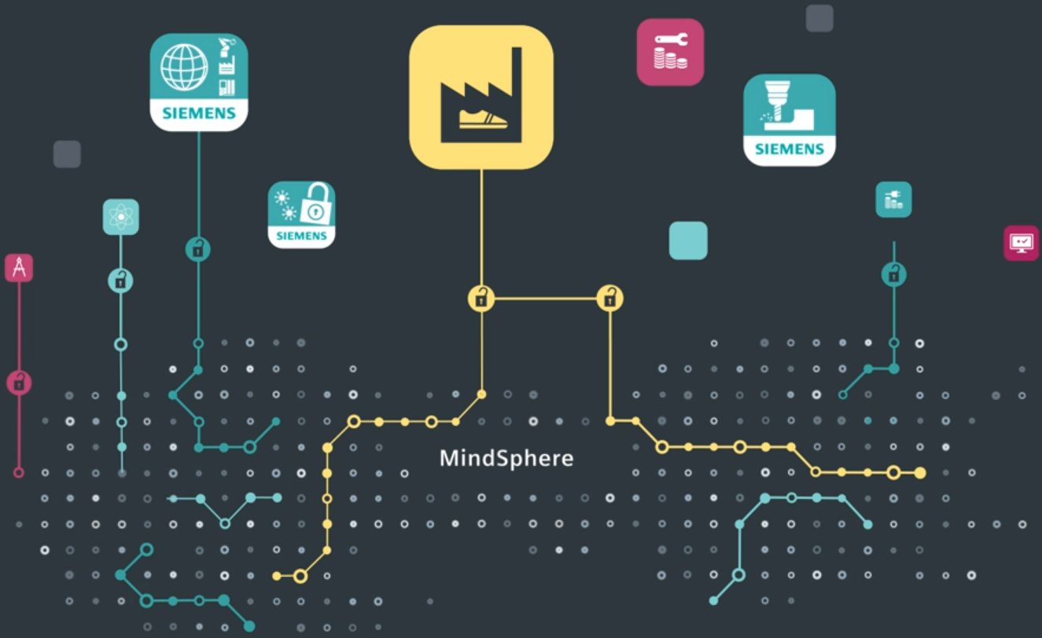
CONTENT
2
3
1
4
Problem definition
Cloud based platform
Introduction to IIoT
Cloud system

Slide 3
01
Industrial Revolutions
The 1st Industrial Revolution
Mechanized production, water and steam power
The 2nd Industrial Revolution
Mass production, electric power
Internet Revolution
Automation, electronics and information technology
Industrial Internet (IIOT)
Digital revolution
Notes:
We stand on the brink of a technological revolution . Look back at the history of industrial revolution.
The First Industrial Revolution used water and steam power to mechanize production. The Second used electric power to create mass production. The Third used electronics and information technology to automate production. Now a Fourth Industrial Revolution is building on the Third.

Slide 4
01
IIOT: the Industrial Internet of Things
Incorporating machine learning and big data technology
Harnessing the sensor data, machine-to-machine(M2M) communication and automation technology
The data can enable companies to pick up on inefficiencies and problems sooner, saving time, money and supporting business intelligence efforts.
Industry 4.0
Tesla
Cloud
Notes:
IIoT incorporates machine learning and big data technology, harnessing the sensor data, machine-to-machine (M2M) communication and automation technologies The data can enable companies to pick up on inefficiencies and problems sooner, saving time and money and supporting business intelligence efforts.

Slide 5
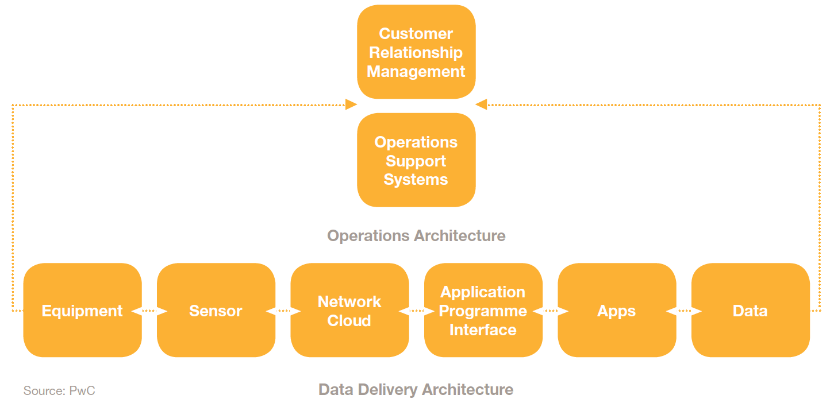
01
IOT Systems & Platforms
One IoT device connects to another to transmit information using Internet transfer protocols.
IoT platforms serve as the bridge between the devices' sensors and the data networks.
GE predix | Mindsphere | ABB Ability | Amazon AWS IOT | IBM IOT Fundation
PTC ThingWrox | Uptake Technology | RootCloud | COSMOS Platform | CASICloud
Notes:
One IoT device connects to another to transmit information using Internet transfer protocols.
IoT platforms serve as the bridge between the devices' sensors and the data networks.
The following are some of the top IoT platforms on the market today:

Slide 6
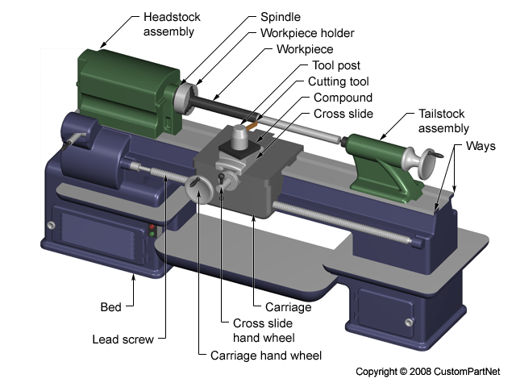
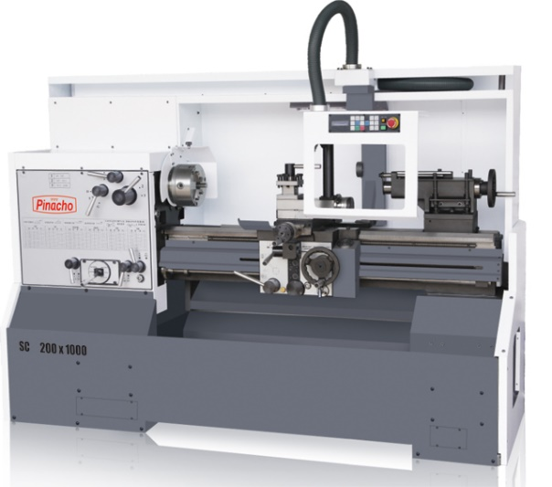
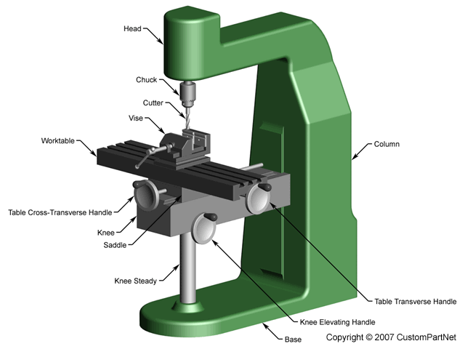
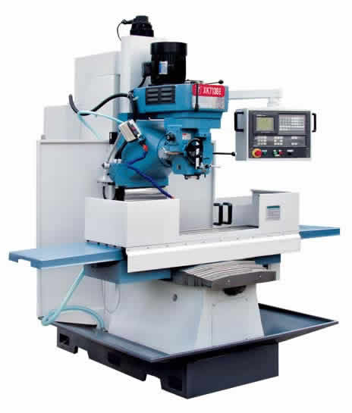
02
Problem Definition
What are machine tools?
machine tools are high accuracy machine used to shape metal parts
Different types of machine tools:
Lathe Machine: The material spins
Milling Machine: The cutting tool spins

Slide 7
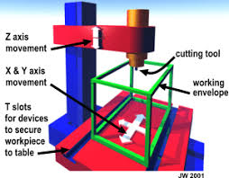
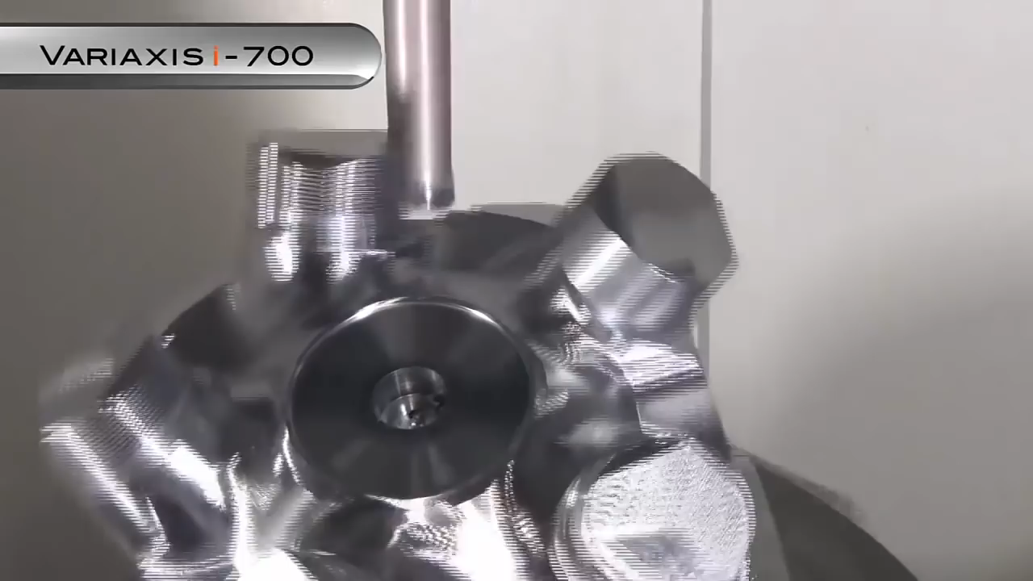
02
Problem Definition
How a machine tool works?
A machine tools is composed of many accurate moving parts; Bearings, Shafts, Screws, Gears, …
Any change can lead to inaccuracy, machine failure, and increase the downtime of the machine

Slide 8
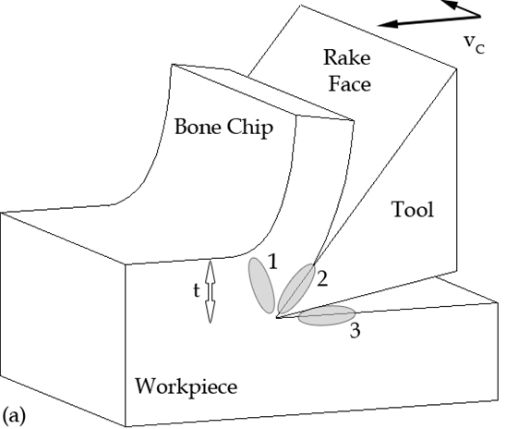
02
Problem Definition
The force between the cutting tool and the work peace can be transferred to the whole machine
Vibration
Temp. rise
Sounds
Environmental
Condition
Inaccuracy, wear in other parts, parts failure,…
High Cost
Tool wear

Slide 9
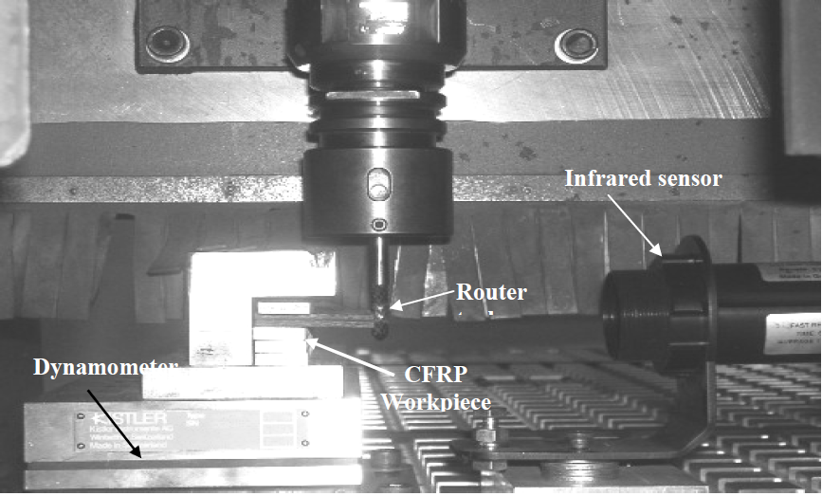
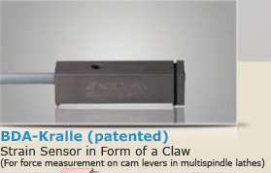
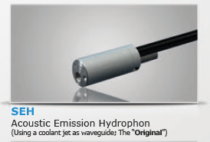
02
Problem Definition
Our first goal is using sensors to find the changes in vibrations, temperature, ... (DATA acquisition)
Different sensors can be used for MCM (Machine Tools Condition Monitoring)
Vibration sensors (Accelerometer)
Force sensors (Dynamometer) ; Expensive
Strain sensors; not very common
AE Sensors (Acoustic Emission)
Temp. sensors (thermometer)
Torque sensors

Slide 10
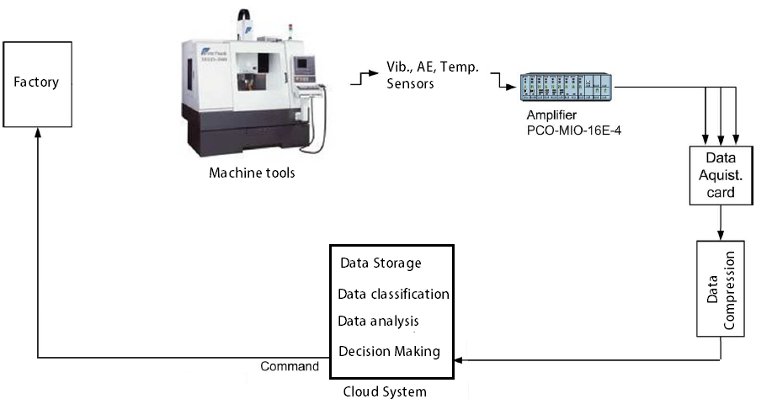
02
Problem Definition
Selected Sensors
Vibration sensors (Accelerometer)
AE Sensors (Acoustic Emission)
Temp. sensors (thermometer)
Challenges
Really Big DATA
The data includes a lot of noises
Effective features should be extracted from the data (DATA analysis)
Powerful decision making algorithm

Slide 11
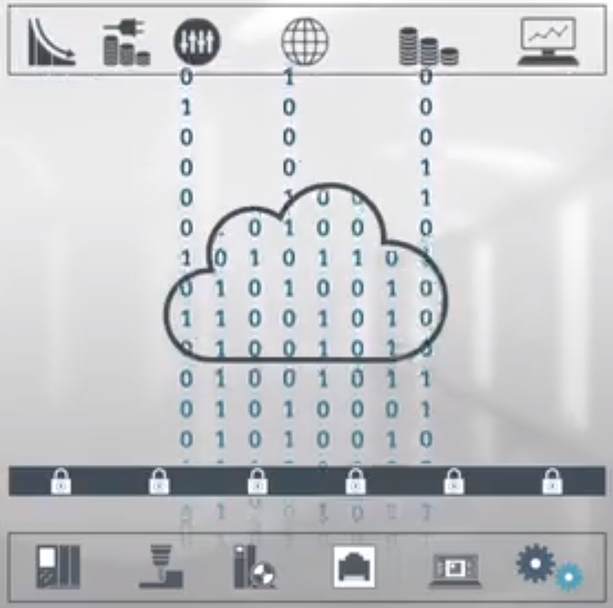
03
Introduction to MindSphere
Cloud Based Operation System
MindSphere is the cloud-based, open IoT operating system from Siemens that connects your products, plants, systems, and machines, enabling you to harness the wealth of data generated by the Internet of Things (IoT) with advanced analytics.
Notes:
As mention those challenges above, we need to find a powerful tool somewhere. The cloud with awesome capability of data storage and processing comes to our eyes. Siemense has considered that problem and provided a great solution, called MindSphere. It is a cloud based operation system.

Slide 12
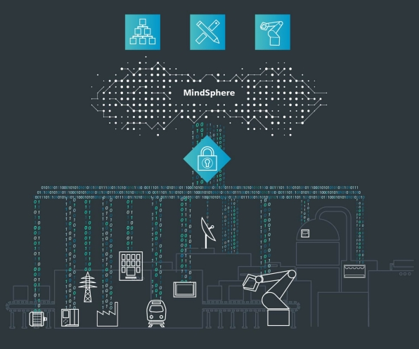
03
How to use MindSphere
Configuration:
Large quantities of machines and plants can generate extreme various and big data.
Siemens provides MindConnect element for collecting data to synchronize it to MindSphere.
Through this platform, users can use the APIs to develop their own applications to monitor the machines and plant and optimize the resource management.
Notes:
First you have your machines and plants with a large number, which can generate extrame various and big data.
Mindshpere can also connect to the third party machines.

Slide 13
03
Why MindSphere
Benefits:
Optimize and arrange the manufacture of machine with higher effeciency.
Insure the long, stable and normal operation time of factory. Maximize the benefits and rearrange the productive resources.
The open environment provide many APIs for developers to adapt various conditions.

Slide 14
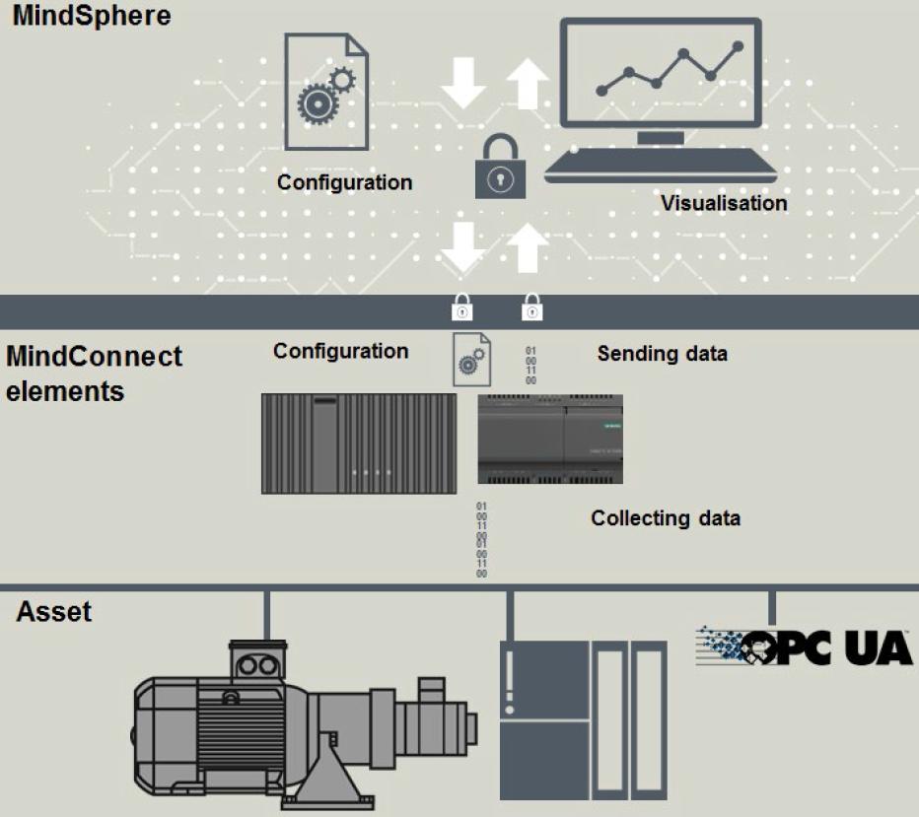
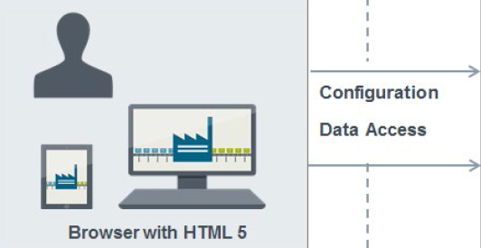
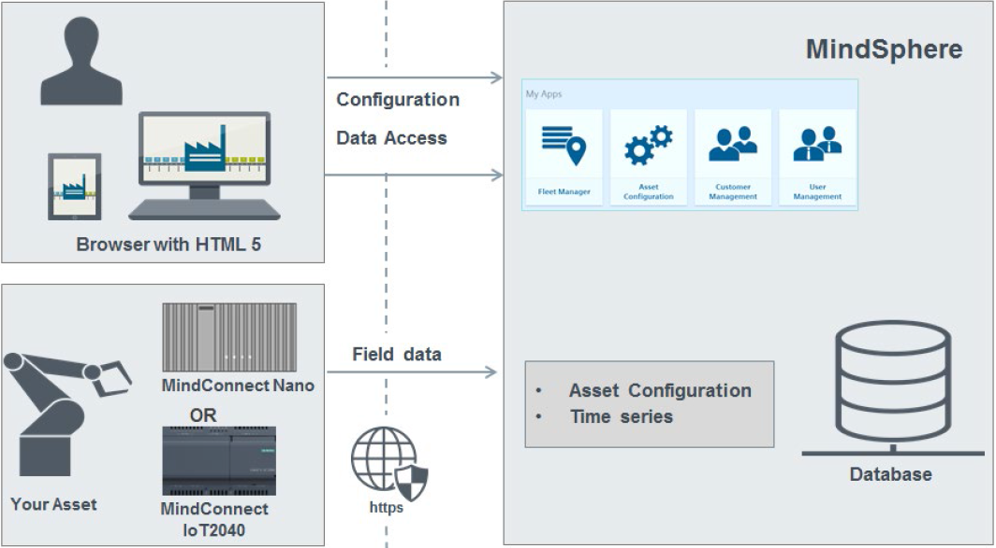
03
A Example for Application
MindSphere provides developers with his APIs to configure the monitoring and analysis applications.
MindSphere Launchpad contains MindSphere Asset Configuration, MindApp Fleet Manager, MindSphere User and Customer Management.
MindConnect element can collect data from assets and transfer it to MindSphere.
MindConnect Nano and MindConnect IoT2040 are the tow typical products which should be connected via Ethernet to PLCs or OPC UA server with S7 protocol.
The assets produce large quantities of data which is not very useful.
Notes:
After the connecting is done, MindSphere Launchpad as an entry point is used to configure and visualize data, to produce a digital copy of your real asset.

Slide 15
04
Cloud System
Service models
Cloud Clients
Infrastructure as a service (IaaS)
Platform as a Service (PaaS)
Software as a Service (SaaS)
SaaS
PaaS
IaaS
Notes:
The NIST's definition of cloud computing describes IaaS as "where the consumer is able to deploy and run arbitrary software, which can include operating systems and applications. The consumer does not manage or control the underlying cloud infrastructure but has control over operating systems, storage, and deployed applications; and possibly limited control of select networking components (e.g., host firewalls)."
The NIST's definition of cloud computing defines Platform as a Service as: The capability provided to the consumer is to deploy onto the cloud infrastructure consumer-created or acquired applications created using programming languages, libraries, services, and tools supported by the provider. The consumer does not manage or control the underlying cloud infrastructure including network, servers, operating systems, or storage, but has control over the deployed applications and possibly configuration settings for the application-hosting environment.
Application developers can develop and run their software solutions on a cloud platform without the cost and complexity of buying and managing the underlying hardware and software layers. With some PaaS offers like Microsoft Azure, Oracle Cloud Platform and Google App Engine.
The NIST's definition of cloud computing defines Software as a Service as: The capability provided to the consumer is to use the provider's applications running on a cloud infrastructure. The applications are accessible from various client devices through either a thin client interface, such as a web browser (e.g., web-based email), or a program interface. The consumer does not manage or control the underlying cloud infrastructure including network, servers, operating systems, storage, or even individual application capabilities, with the possible exception of limited user-specific application configuration settings.

Slide 16
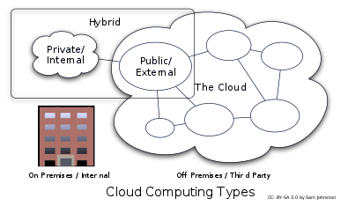
04
Cloud System
Service models
Private Cloud
Public Cloud
Hybrid Cloud
Notes:
Private cloud is cloud infrastructure operated solely for a single organization, whether managed internally or by a third-party, and hosted either internally or externally . They have a significant physical footprint, requiring allocations of space, hardware, and environmental controls. These assets have to be refreshed periodically, resulting in additional capital expenditures.
"public cloud”: the services are rendered over a network that is open for public use. Public cloud services may be free. Technically there may be little or no difference between public and private cloud architecture, however, security consideration may be substantially different
Hybrid cloud is a composition of two or more clouds (private, community or public) that remain distinct entities but are bound together, offering the benefits of multiple deployment models. Gartner defines a hybrid cloud service as a cloud computing service that is composed of some combination of private, public and community cloud services, from different service providers.

Slide 17
Tsinghua
IDED Course
THANK YOU

